Slide 1
Mobile application based on ar and iot
HARI HARAN M.V
124006058
MANOJ R.D.
124006059

Slide 2
PRESENTATION OUTLINE
PROBLEM STATEMENT
OBJECTIVE OF THE WORK
METHODOLOGY
TIME LINE ACTIVITY
REFERENCE

Slide 3
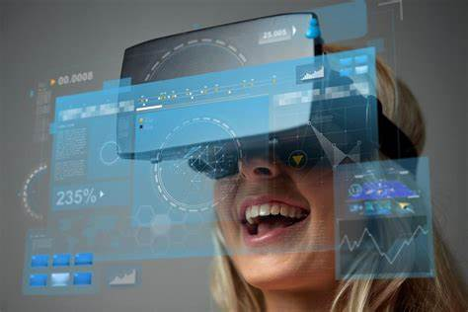
PROBLEM STATEMENT
Recent advancement in smartphone technology has fueled the popularity of Augmented Reality in mobile devices. This project presents an introduction to mobile Augmented Reality. We focus on the key technology required to develop a mobile Augmented Reality application. Discussing the existing problems and a generic framework required for its development.

Slide 4
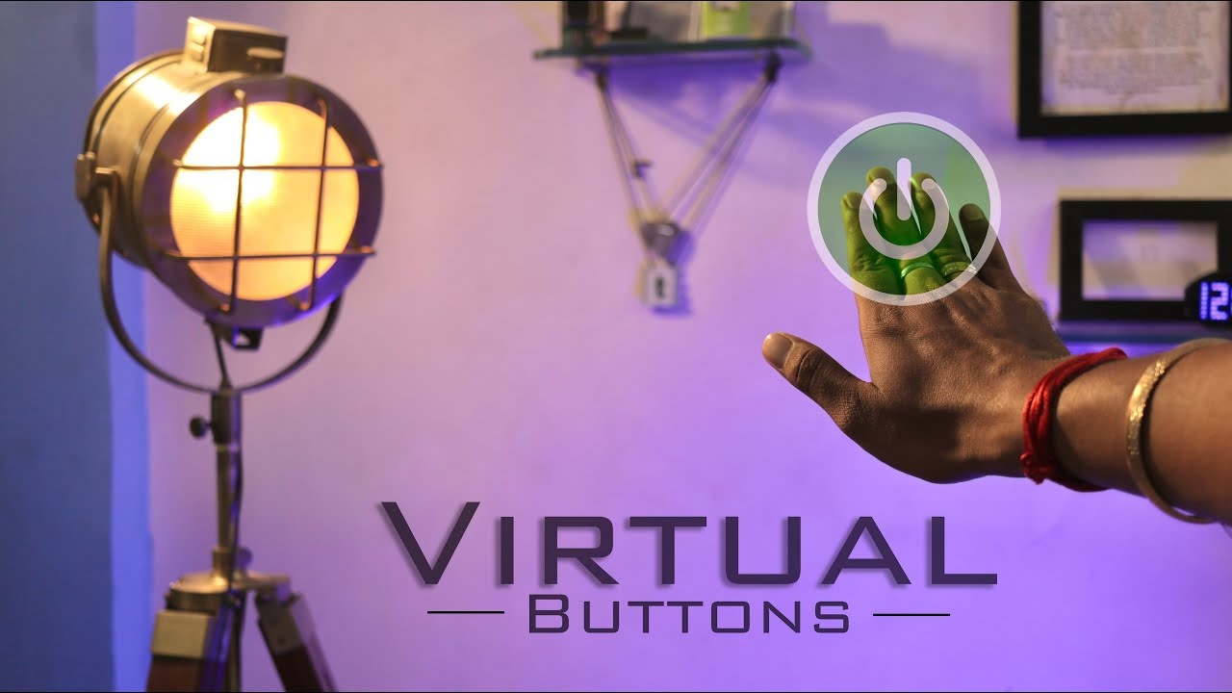
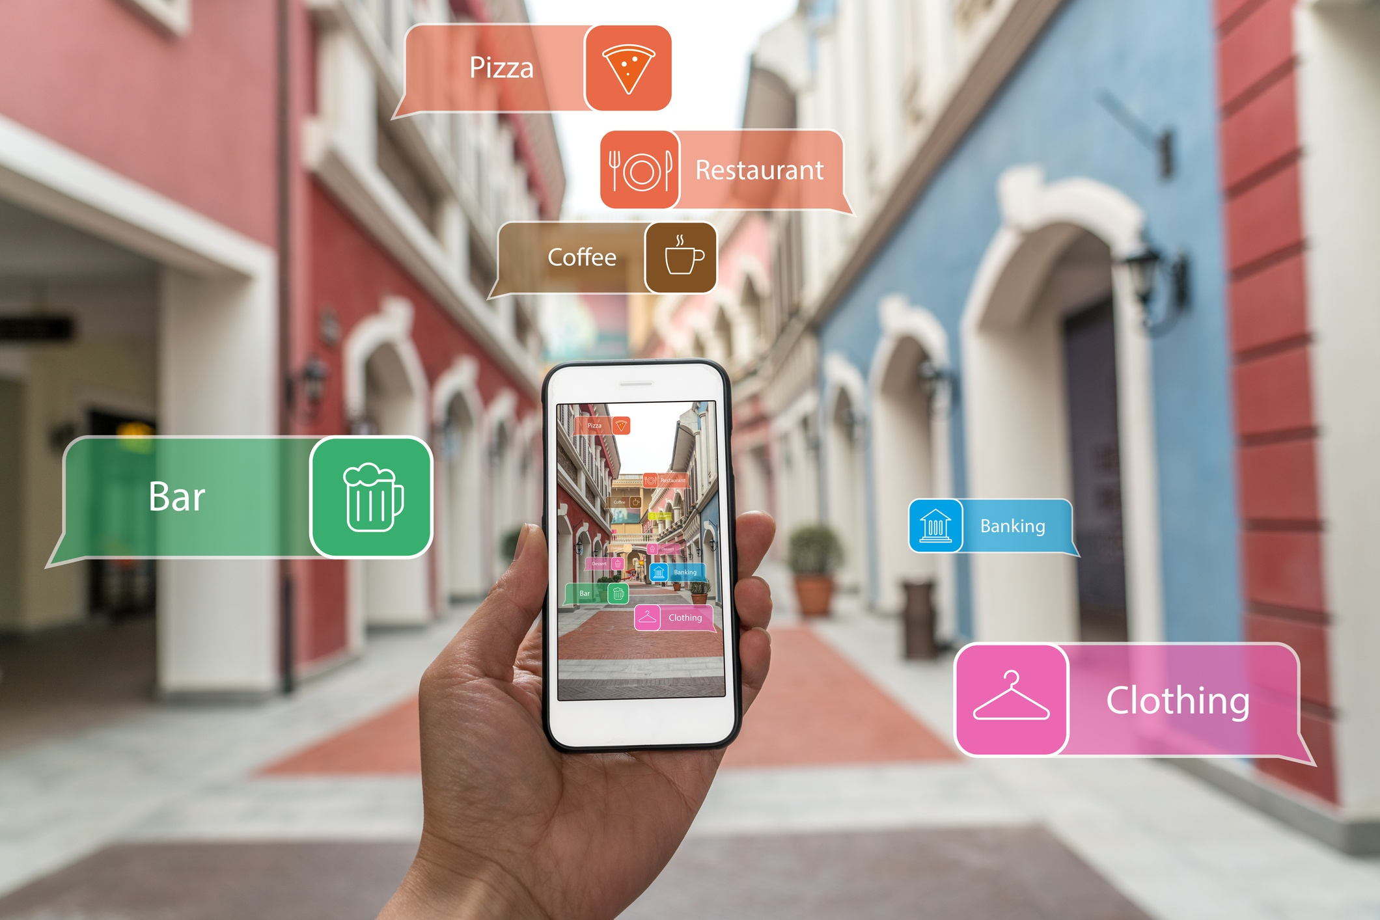
OBJECTIVE OF THE WORK
Mobile applications based on Augmented Reality and Internet of Things (AR and IoT) are becoming increasingly popular. By combining the two technologies, developers can create powerful and engaging applications that bring the physical world to life in ways never before possible.AR and IoT applications can be used to create immersive experiences that can be used for gaming, education, business, and more. These technologies can also be used to create interactive applications that can be used to access real-time data, control physical devices, and even interact with the environment.

Slide 5
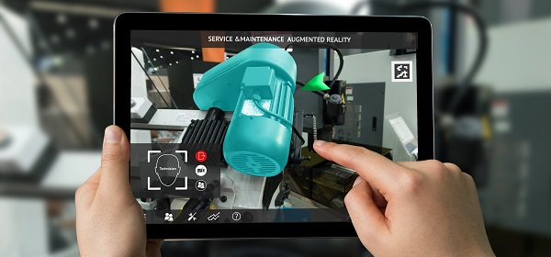
METHODOLOGY
- KEY TECHNOLOGY
Object Detection
Recognition Technology
Calibration
Model rendering
Display interaction technology
-Software Frameworks(as of now)
Unity
Vuforia
Tensorflow
Sensor and actuators for iot implementation
Any other future needs..

Slide 6
TIME LINE ACTIVITY
Yet to start
Zeroth review
Ideas and research on the project

Slide 7
REFERENCE
https://youtu.be/pjjN5PecVLk
https://youtu.be/WzfDo2Wpxks
AUGMENTED REALITY IN MOBILE DEVICES By Sneha Kasetty Sudarshan(ONLINE SOURCE)

Slide 8
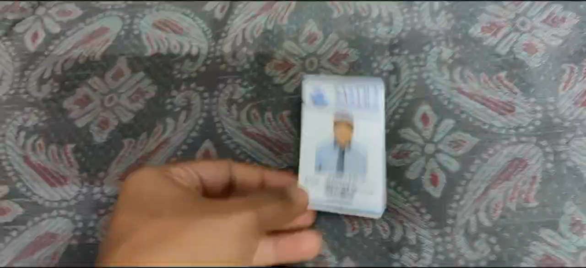
OUTPUT :

